Slide 1
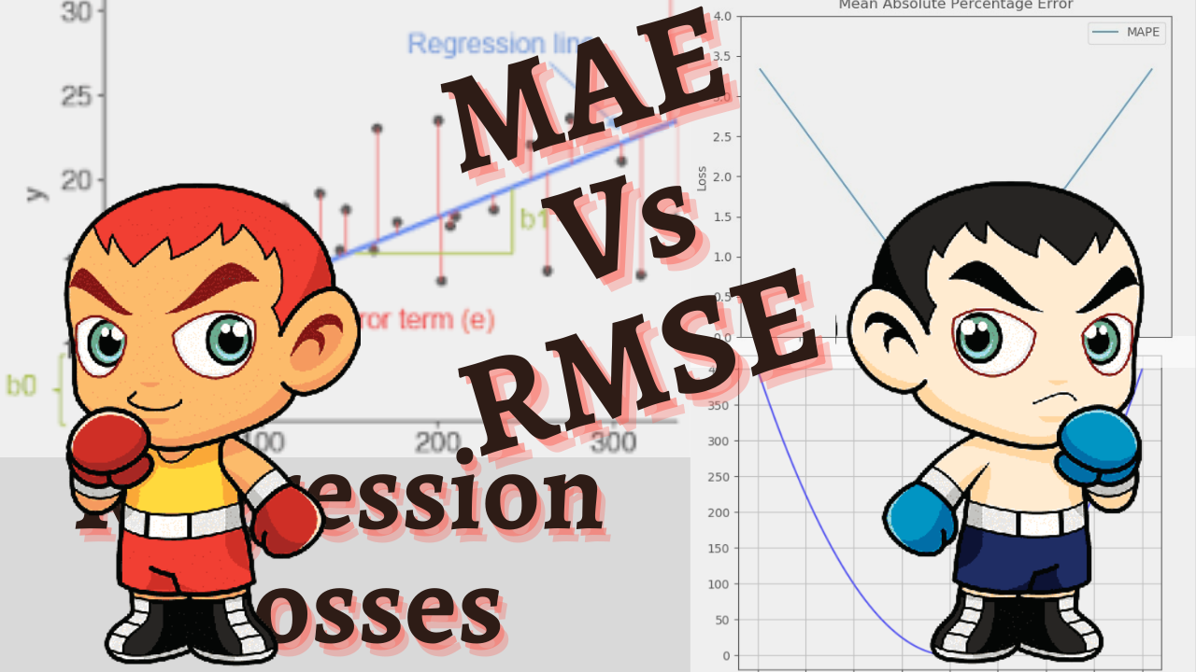

Slide 2
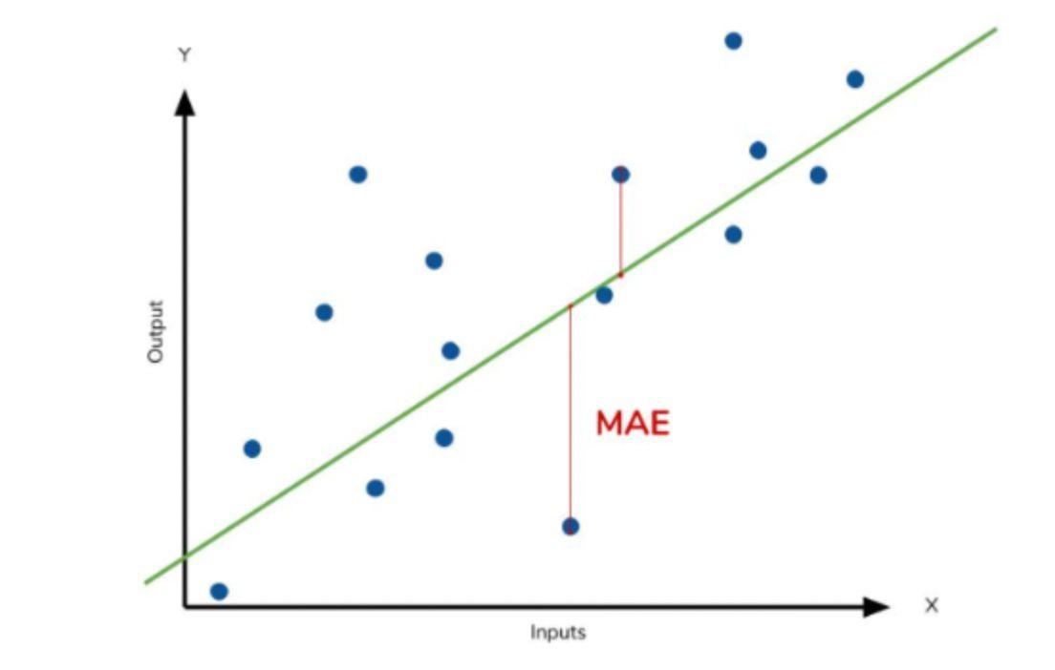

MAE (Mean Absolute Error)

Slide 3
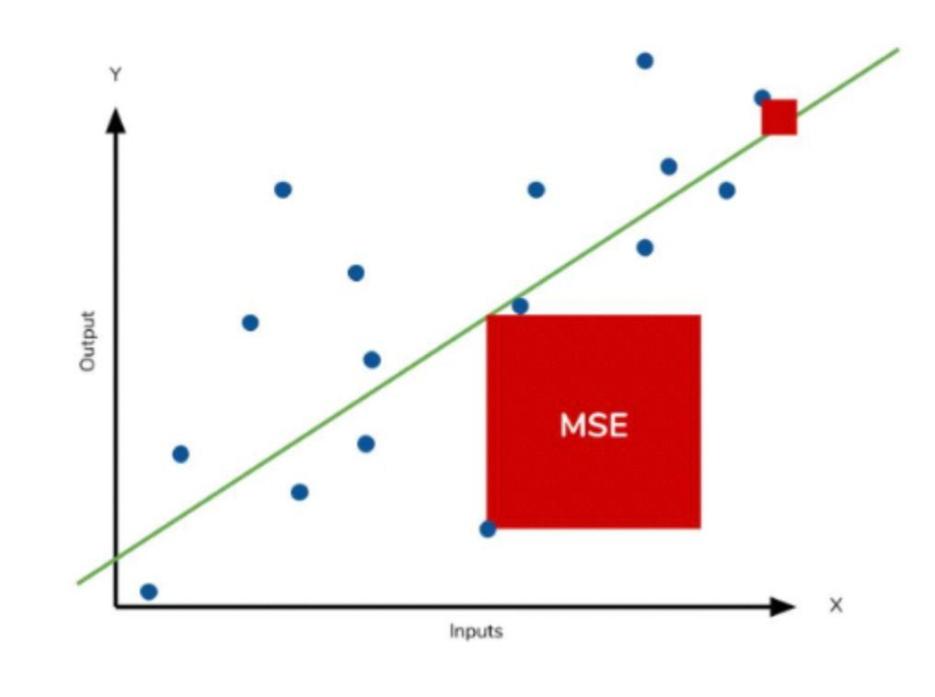
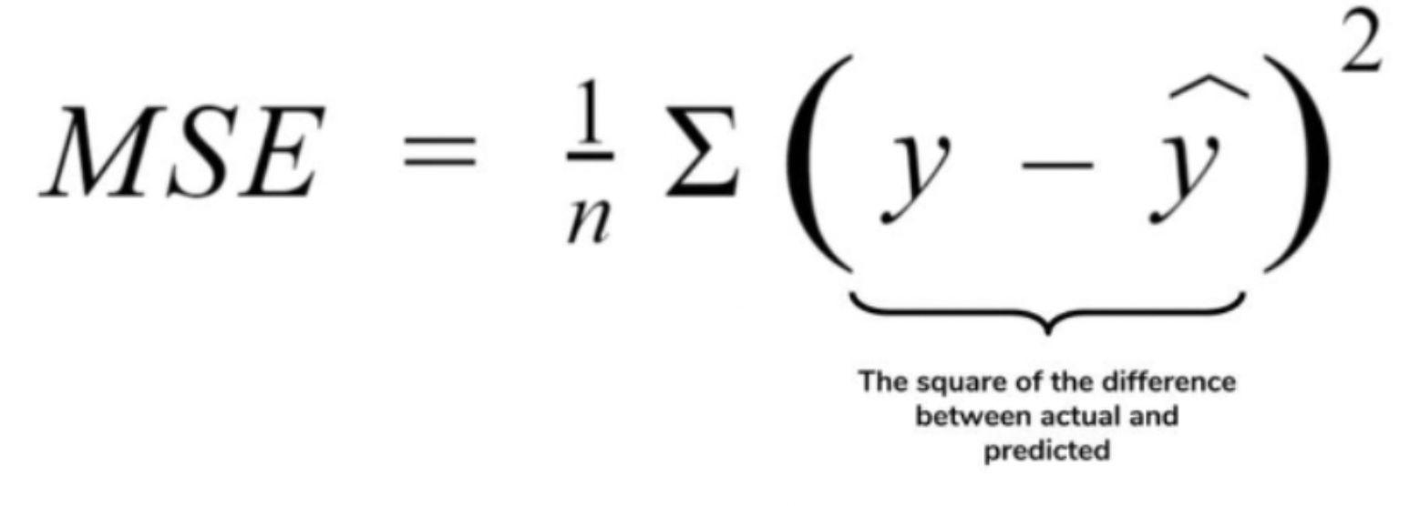
MSE (Mean Squared Error)

Slide 4
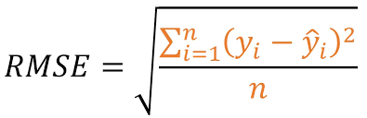
RMSE (Root Mean Squared Error)
R
M
S
E

Slide 5
Similarities
Distance based metrics
Negatively oriented scores - lower values are better
Range - 0 to ∞
Mean or Average prediction across whole dataset

Slide 6
Differences
MSE or RMSE gives high weightage to large errors
MAE treats all errors the same way
MAE <= RMSE
MAE is easily interpretable
RMSE is more sensitive to noise or outliers
MSE/RMSE are smooth functions and easy to differentiate

Slide 7
Robustness

